Slide 1

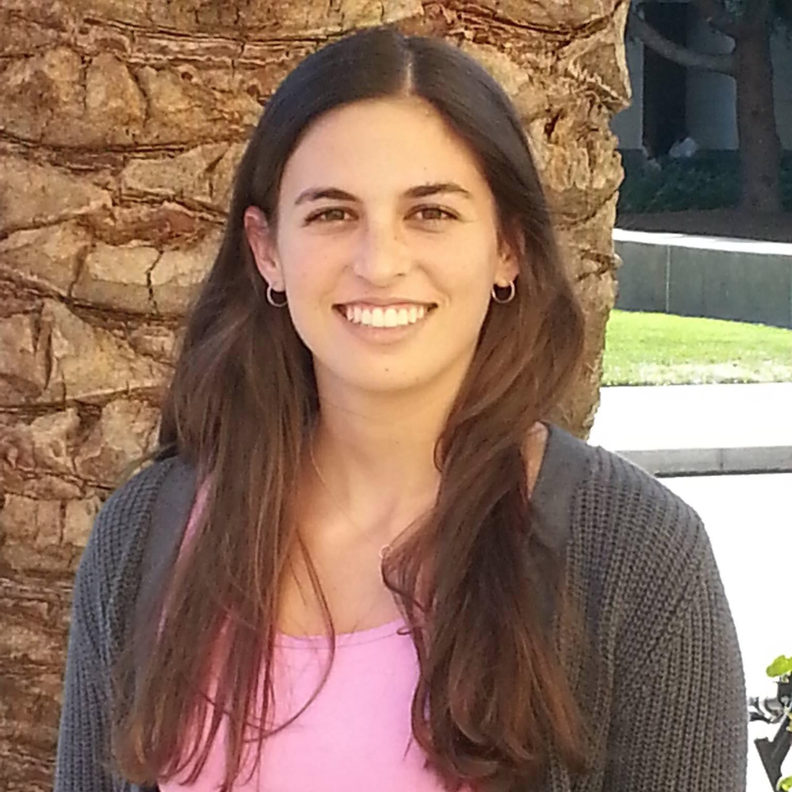
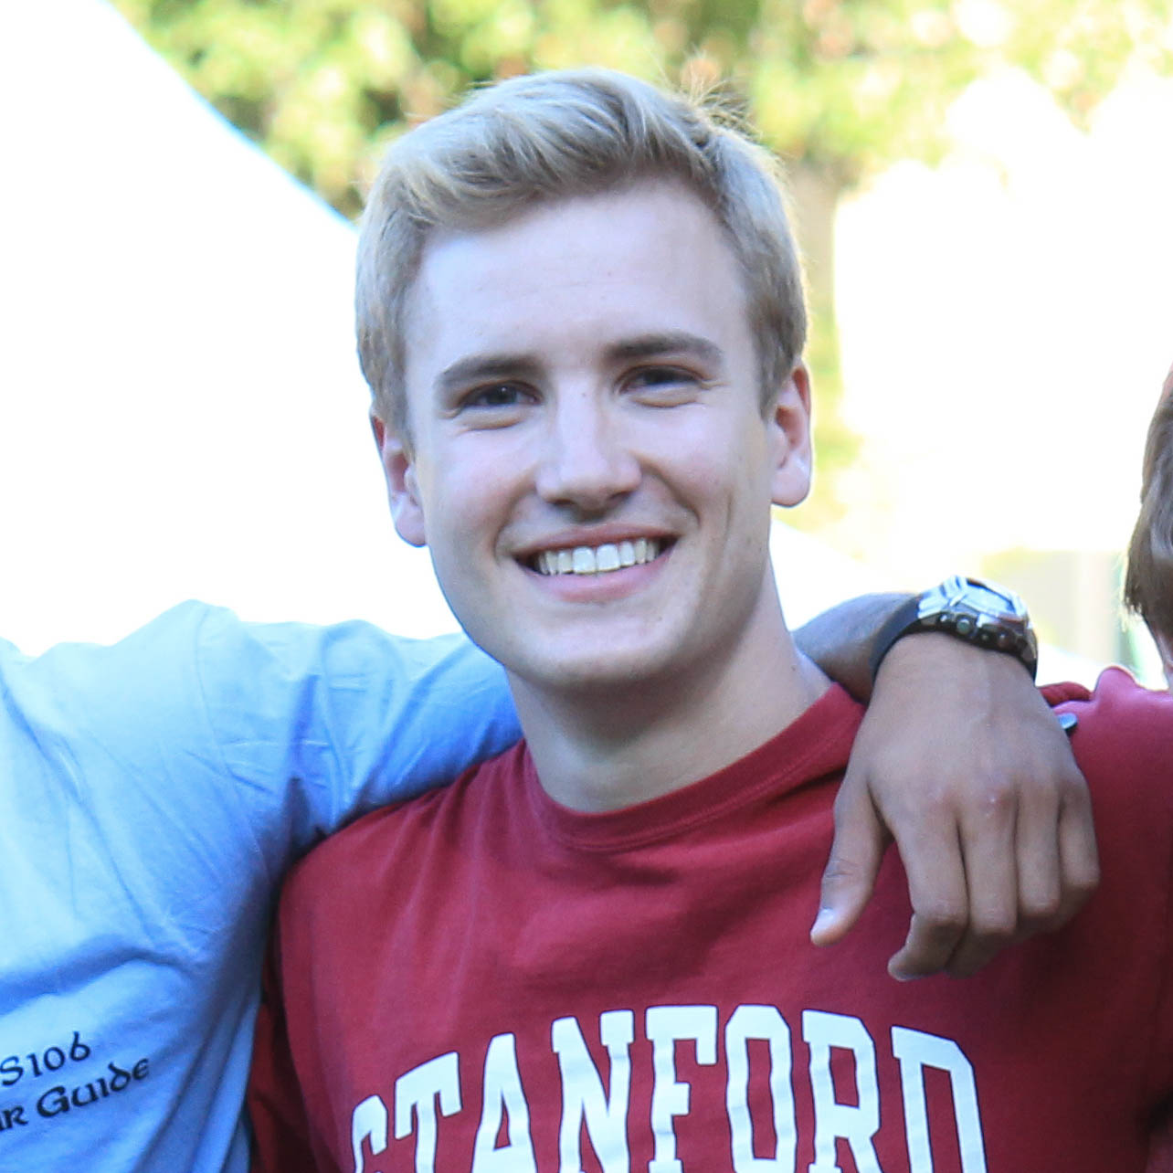
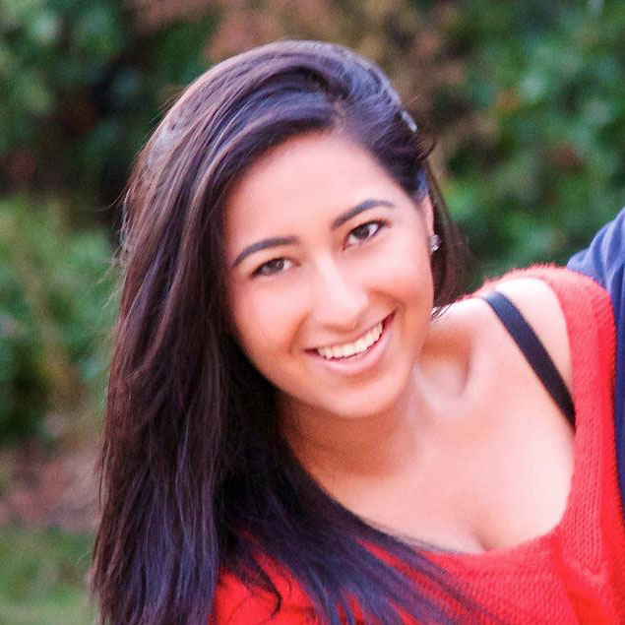
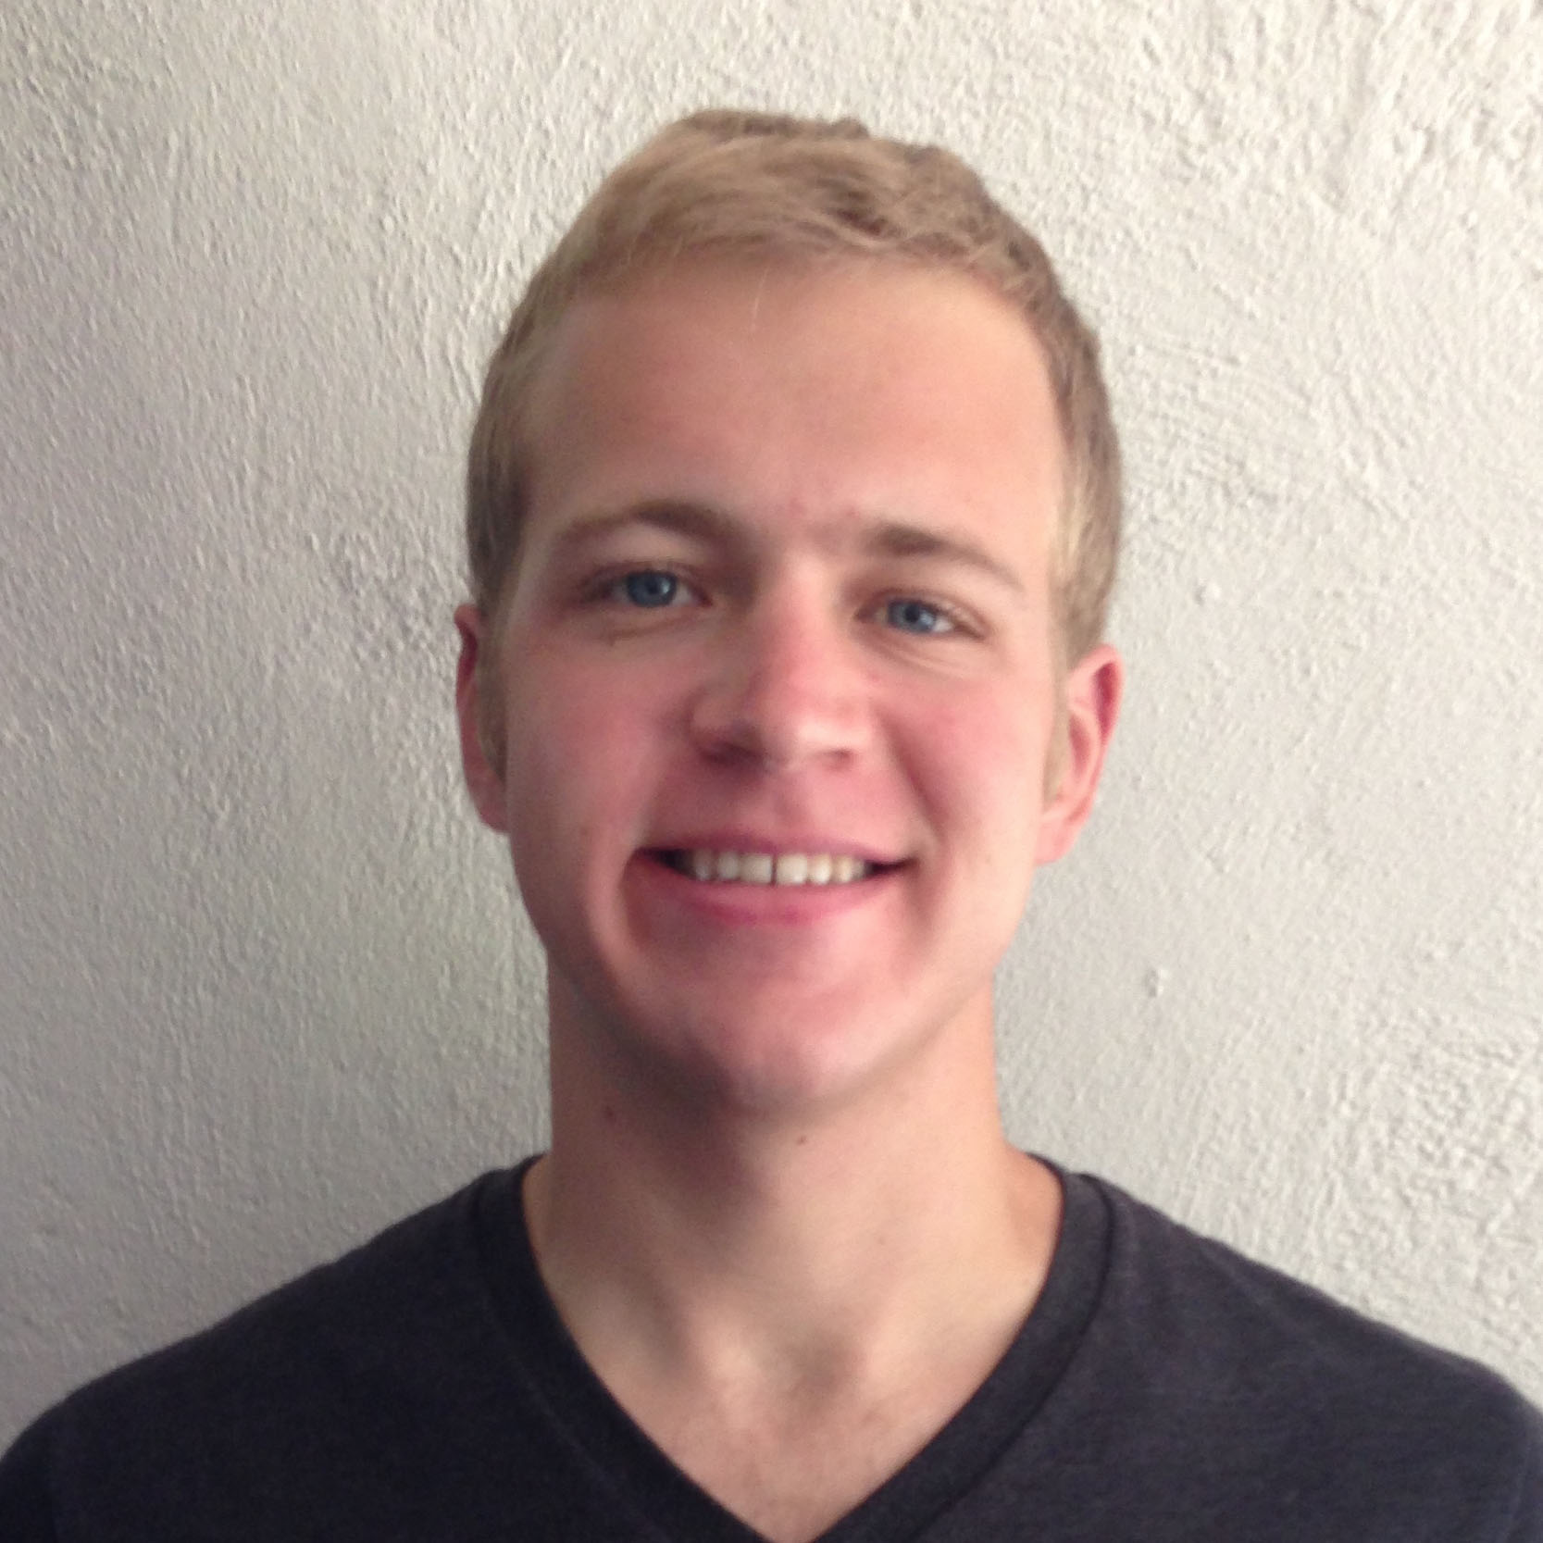
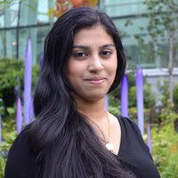
NightOwl
Lab Usability Study
Griffin Dietz - Lachlan Green - Zara Saraon - Evan Nixon - Priyanka Rao
Notes:
Go over the findings from the Lab Usability tests we conducted this week

Slide 2
Setup

Slide 3

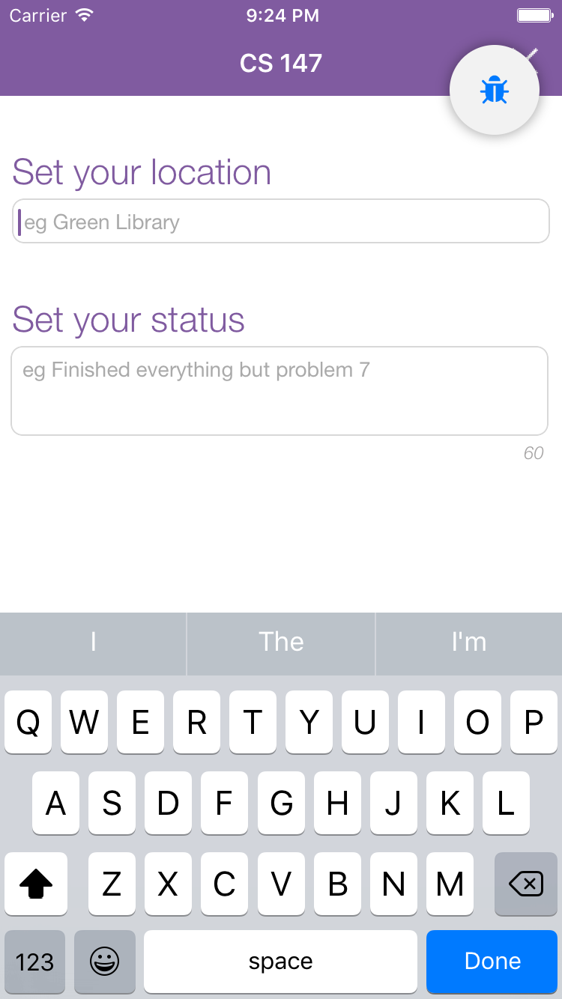
Prototype Changes
included Lookback
keyboard done button
Notes:
Before starting testing, we included Lookback in our app, which allowed us to record usability tests to go back and log quantitative data.
We also made a small changes based on feedback we received at the project fair. We changed the return button on all keyboards to a done button, and had that done button resign the keyboard.

Slide 4
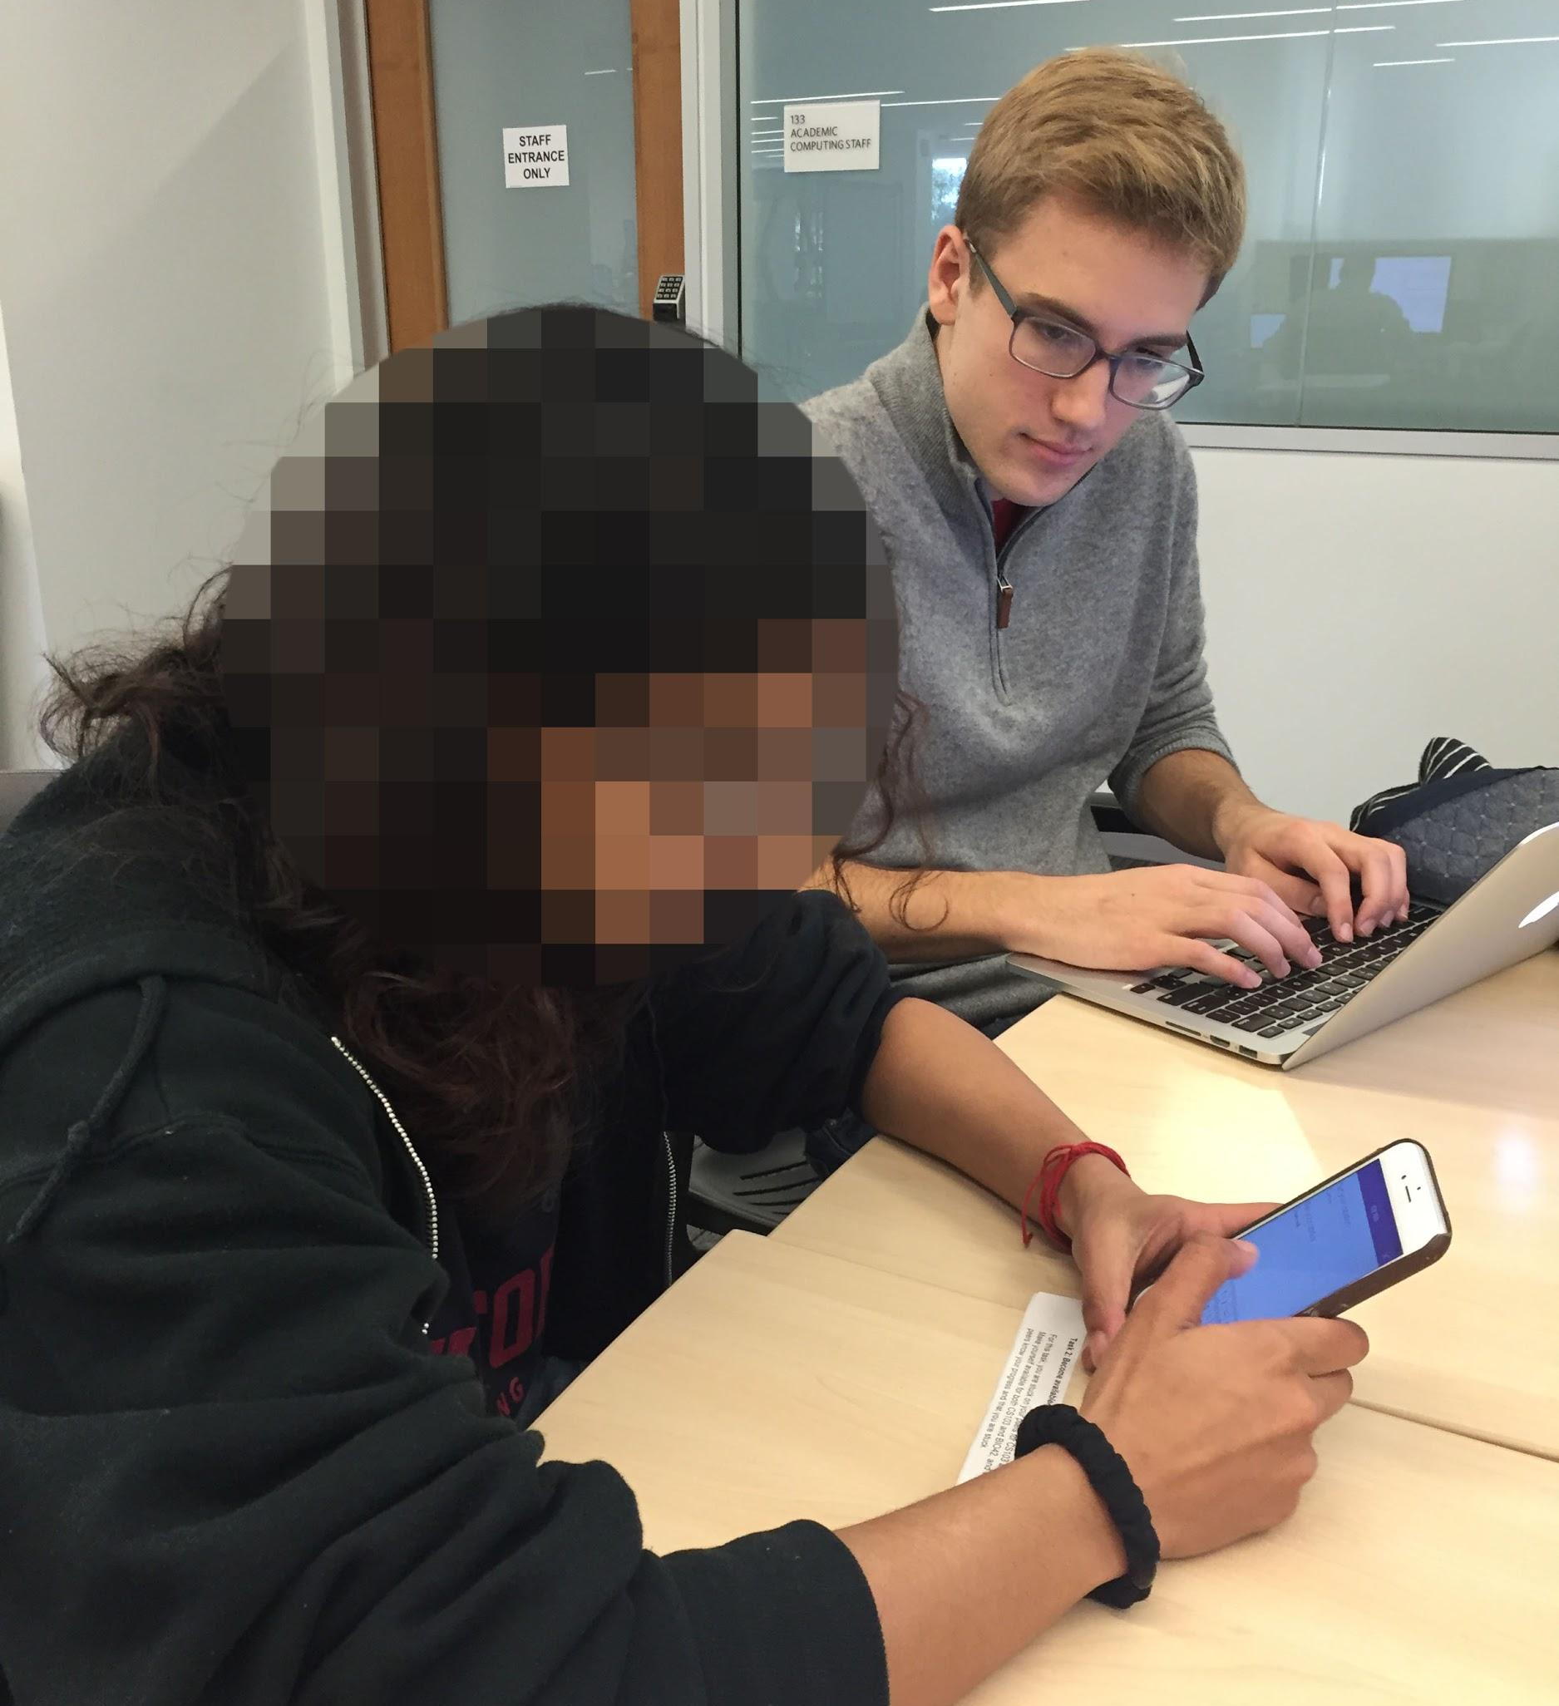
Participants
4 Stanford students, 1 student from a different college
Stanford students chosen at random

Slide 5
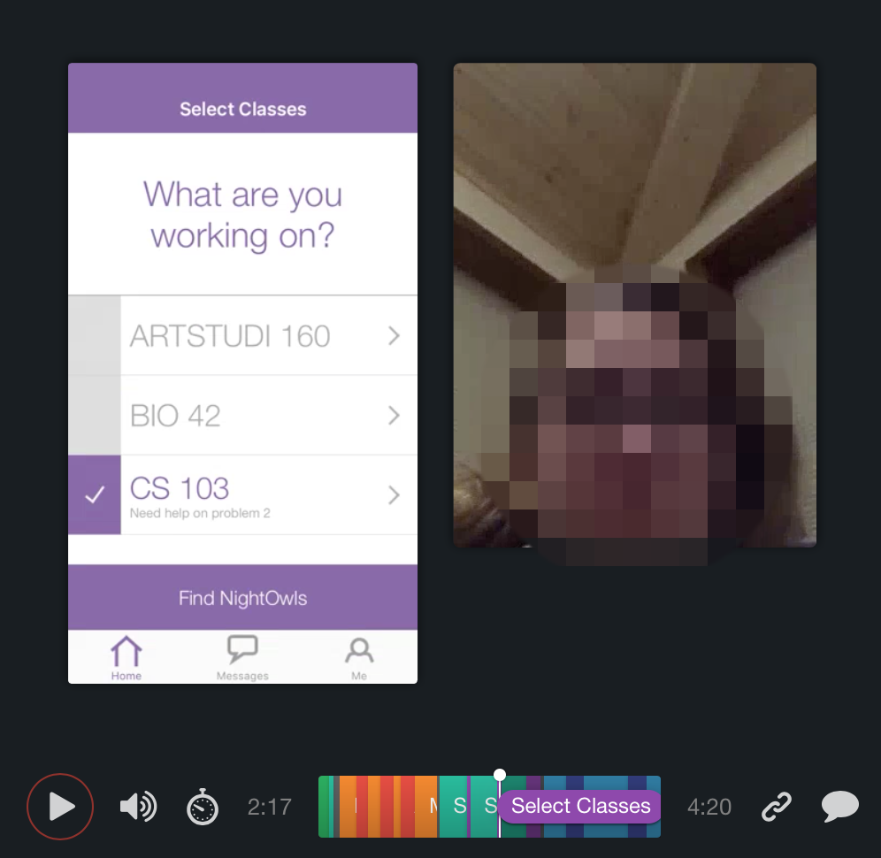
Apparatus
used Lookback
tested in isolated area in Lathrop and in bedroom
Notes:
In conducting our tests, we used Lookback to record the actions and video of participants.
We ran our tests either in an isolated area in Lathrop, or in a quiet bedroom.

Slide 6
Tasks

Slide 7
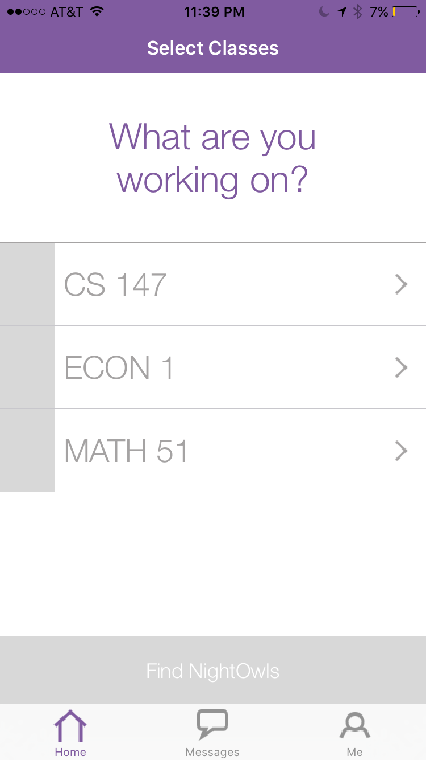
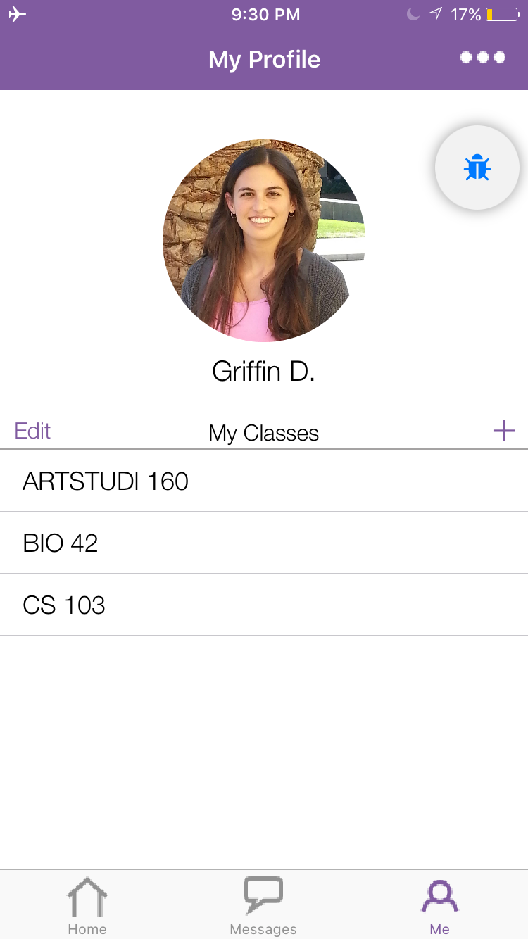

Simple Task: Update list of current classes
Notes:
Description of task: We gave participants the app with 3 classes already loaded in (left screen) and asked them to update their list of current classes to be 3 new classes (right screen).
What we looked for: 1) If they were able realize the class list can be edited in the “me” tab
2) any errors or confusion with adding/deleting

Slide 8
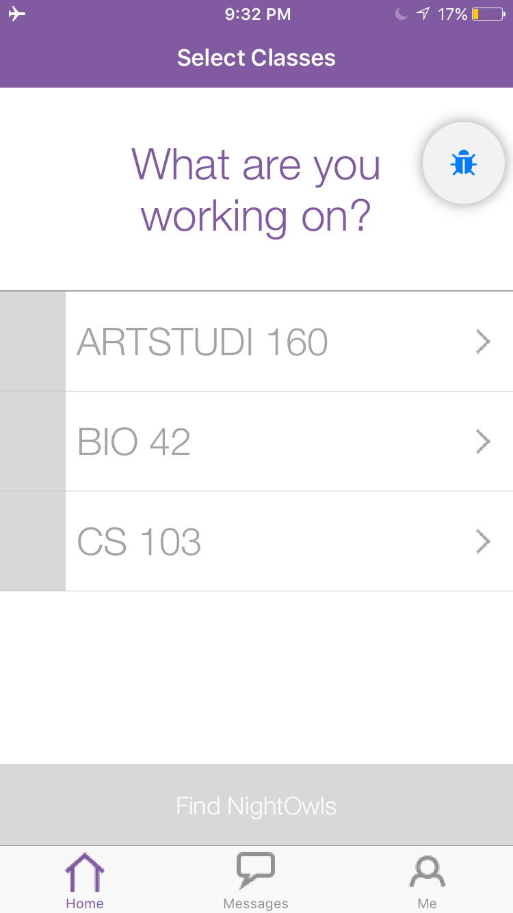
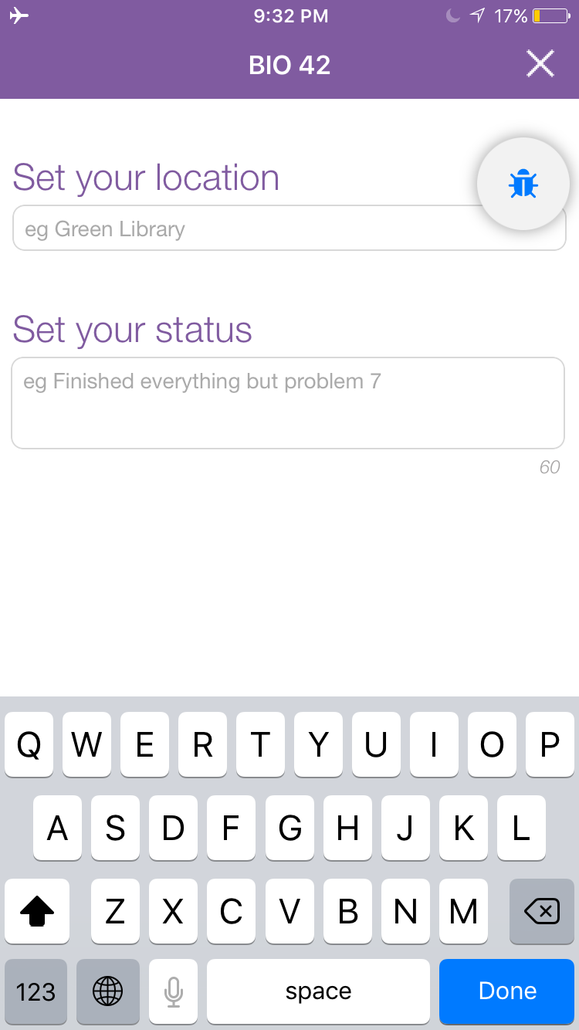
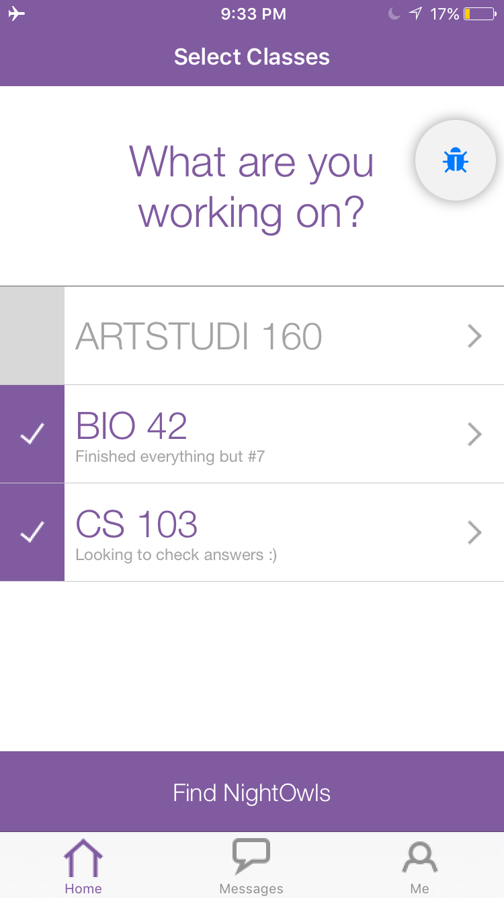
Medium Task: Make yourself available for a class
Notes:
Description of task: We told participants to imagine they are working on psets for CS103 and BIO42 and need help. Their task was to make themselves available for both classes, and post informative statuses.
What we looked for: 1) If they were able to easily make themselves available
2) If there were any issues with entering status or location

Slide 9

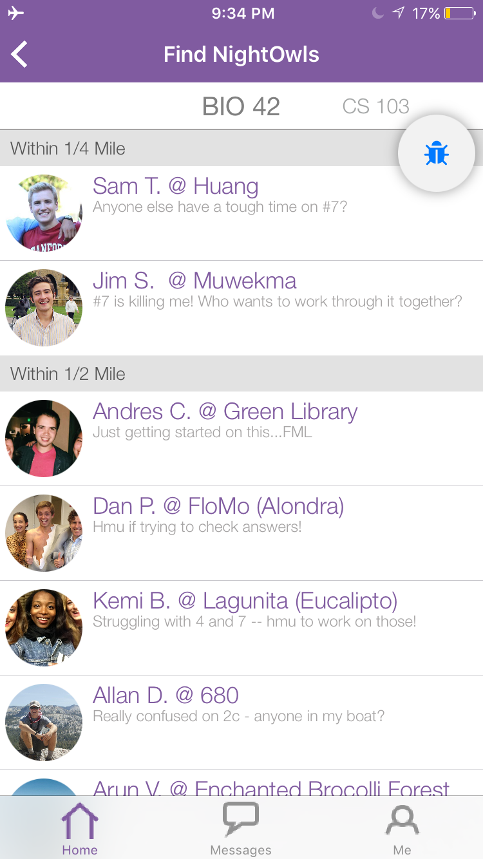
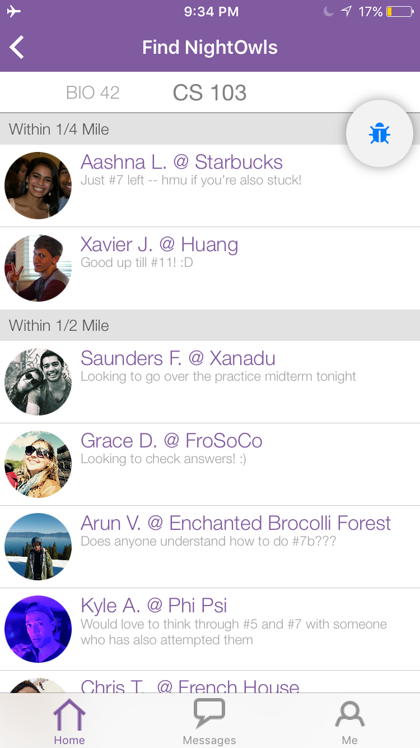
Complex Task: Reach out to classmates
Notes:
Description of task: Now that they have made themselves available, we asked participants to send a message to one of their peers in CS103
What we looked for: 1) If they knew to click the “Find Nightowls” button to access list of available peers
2) If they recognized that the newsfeed was split into two tabs (one for cs103, one for bio42) and if they were able to toggle
between them
3) If they were able to figure out how to message a specific person once on the newsfeed

Slide 10
Procedure & Test Measures

Slide 11
Procedure
Collected consent form
Summarized NightOwl (no demo)
Observed participants completing tasks
Solicited general feedback
Reviewed data with Lookback
Notes:
We followed this set of procedures for all participants

Slide 12
Test Measures
Qualitative
  exclamations/quotes
  points of confusion
  errors
Quantitative
  time/task
  errors/task
  recovery time/error
  taps/task
Notes:
These are our test measures.
Looked largely at qualitative data: like points of confusion of any exclamations users made
Also collected bottom line data including: time per task, errors per task and the like

Slide 13
Results & Discussion
Notes:
I’ll now going to delve into the results task by task.

Slide 14
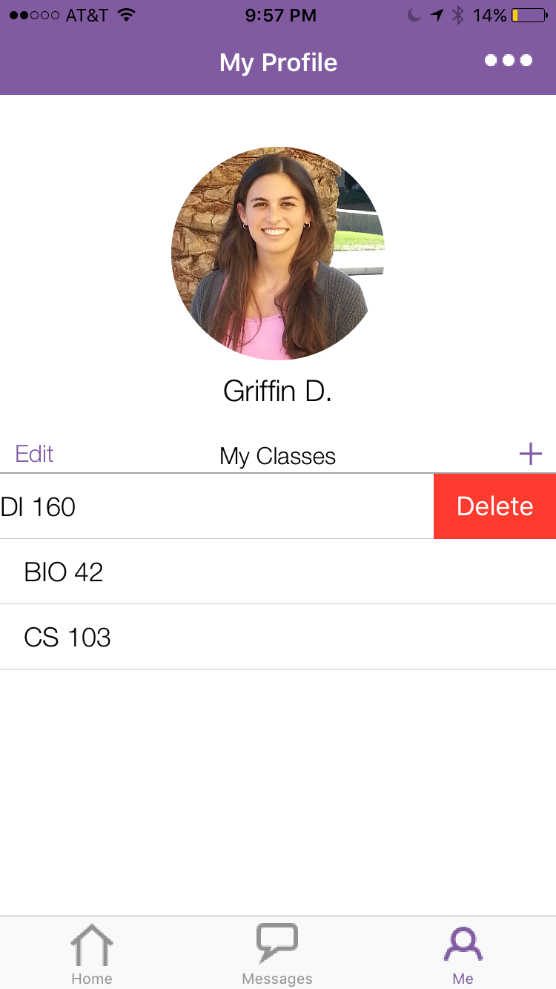
Task 1
What worked
navigation
adding classes w/ search feature
deleting classes
Errors
edit and + button
Notes:
Users were easily able to navigate to the “me” tab, add, and delete classes
Problem: we observed that multiple users had issues with the “edit” and “+” buttons. They had to tap them multiple times because they were too small. One user even said out loud “I think my fingers are too big because this isn’t working.”
WHAT TO CHANGE FROM THESE RESULTS: make edit and + bigger

Slide 15
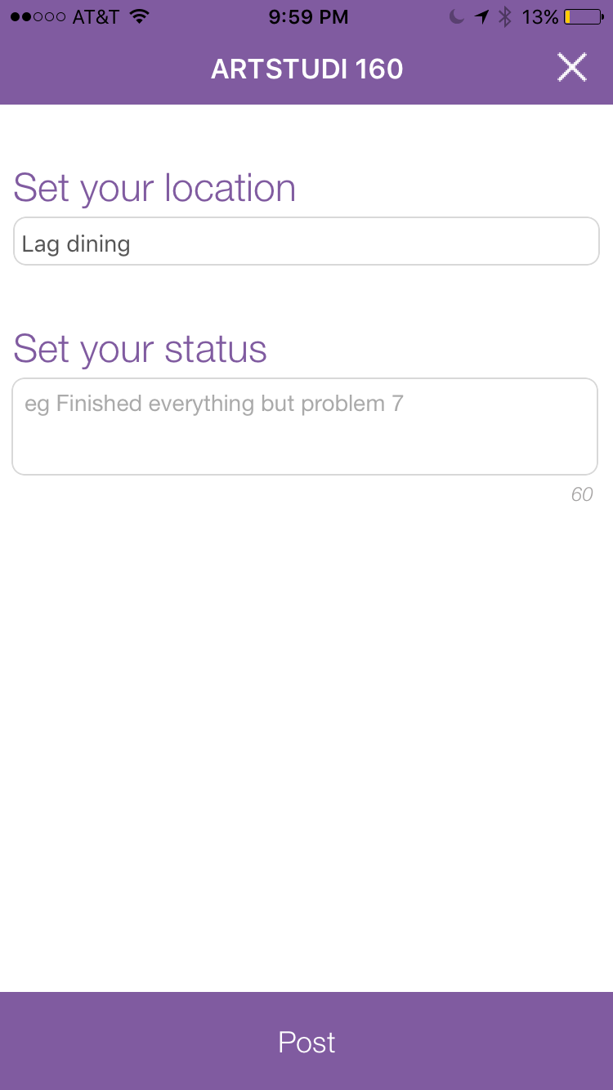
Task 2
What worked
setting a status and location
autofilling location for second class
Errors
none
Notes:
Task 2 went very smoothly: people were able to easily set a status and location. They remarked positively about the fact that location is autofilled for the second class.

Slide 16
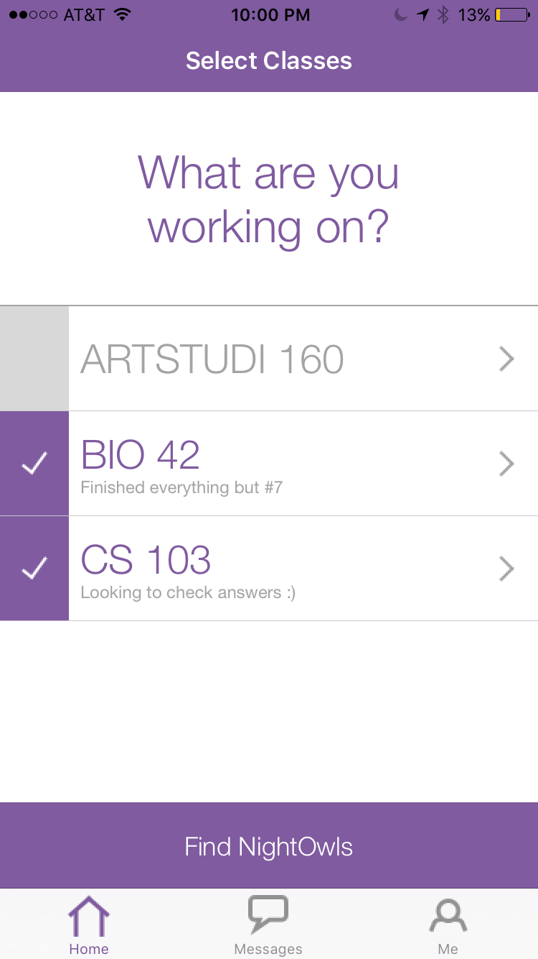
Task 3
What worked
listing by proximity
What didn’t work
“Find NightOwls” button
filtering by class
Notes:
The 2 largest errors we observed came during task 3.
A few users did not know where to go to find a list of their peers in CS103. Some tried tapping the class name, others went straight to the messages tab. Eventually most figured it out, but we observed a lot of confusion.
Once they had navigated to the list of peers, they did not see the class filters at the top of the screen. Our instructions asked participants to message someone in cs103 but some participants accidentally messaged participants in BIO42 because they did not notice the filters.
FROM THESE RESULTS, WE WANT TO MAKE SOME DESIGN CHANGES. 1) Make it clearer that the Find NightOwls button is a button and that it will lead to the list of peers in your classes 2) figure out a way to make the filters more noticeable

Slide 17
Task 3
What worked
listing by proximity
What didn’t work
“Find NightOwls” button
filtering by class
Notes:
The 2 largest errors we observed came during task 3.
A few users did not know where to go to find a list of their peers in CS103. Some tried tapping the class name, others went straight to the messages tab. Eventually most figured it out, but we observed a lot of confusion.
Once they had navigated to the list of peers, they did not see the class filters at the top of the screen. Our instructions asked participants to message someone in cs103 but some participants accidentally messaged peers in BIO42 because they did not notice the filters.
FROM THESE RESULTS, WE WANT TO MAKE SOME DESIGN CHANGES. 1) Make it clearer that the Find NightOwls button is a button 2) figure out a way to make the filters more noticeable

Slide 18
Bottom Line Data
Task | Avg. # errors | Avg. time/task (min) | Avg. recovery time/error (min) | Avg. # taps | Minimum # taps
1 | 1 | 1:10 | 0:05 | 30 | 14
2 | < 1 | 1:07 | 0:12 | 12 | 9
3 | 2 | 1:22 | 0:23 | 9 | 5
Notes:
We also took some bottom line data, summarized here.
There’s a lot here but I’m going to comment on 2 takeaways:
task 2 had the fewest errors, while task 3 had the most errors (and the longest recovery time from errors)
People took many more taps to complete task 1 than necessary

Slide 19
Pilot Run vs “Real” Run
Incorporate all features in tasks
More representative context
iPhone users only
Notes:
In addition to the interface changes that I already mentioned for the “real” experiment we want to do the following:
we realize that some features weren’t actually tested during our 3 tasks: such as a deselecting feature
test on users as they are actually working on psets
select only iPhone users rather than android users as they have a greater familiarity with how to navigate iPhones

Slide 20
Summary
Observed 5 participants
Key Learnings
Add/delete buttons too small
Confusion on how to “Find NightOwls” initially
Problems toggling between classes on “Find NightOwls” page
Notes:
In summary, this week we conducted user testing on 5 people
From this, we learned that the most prominent confusion points were: 1) add/delete buttons need to be bigger, 2) find nightowls button, 3) toggling between classes on peer list page - which we plan to address in the next iteration of the app.

